Slide 1
DHIS2 SMS Mobile Client

Slide 2
Background:
The DHIS2 SMS Client is the least sophisticated mobile module.
It is so designed for small datasets for which reporting could be adhoc.
The SMS client is hardware independent (any mobile phone can communicate with it).

Slide 3
Setting up the DHIS2 SMS
The SMS Mobile runs on an Android Gateway – that is available from the Google play store
This SMS gateway is largely designed for testing (and small deployments) For Larger deployments – a commercial gateway run by a Mobile services provider will be necessary.

Slide 4
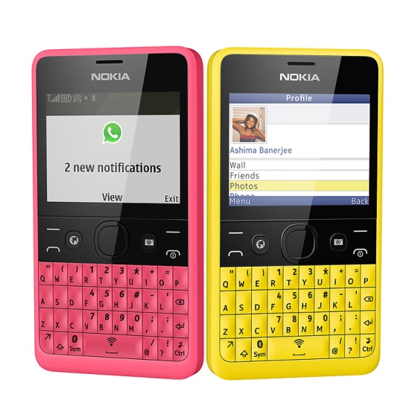
DHIS2 Online Server
SMS GATEWAY

Slide 5
Setting up the DHIS2 SMS Server
The SMS gateway receives data in normal text format (using a Key Word as a parser and data element codes) and forwards the data onto the DHIS2 online server.
The SMS Gateway requires an Android supported device to run.

Slide 6
Google Play store:
https://play.google.com/store/apps/details?id=org.dhis2.androidsms

Slide 7
Configuring SMS Commands
The SMS gateway will forward data based on preconfigured commands, which need to be configured on the DHIS2 server by a user with admin rights;
The place to configure these commands is:
Mobile Configuration > SMS Commands. The Commands are configured to allow for the allocation of a dataset and the allied data elements to be sent.

Slide 8
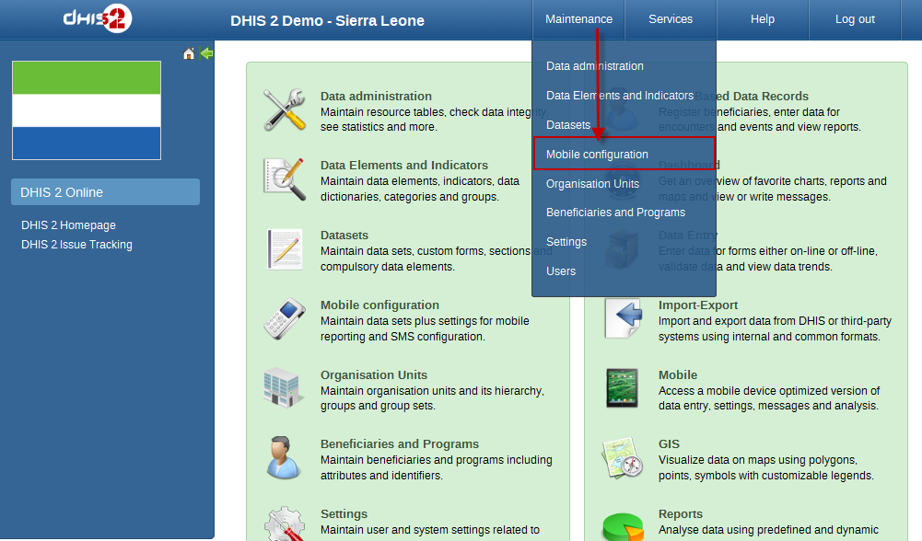
SMS Mobile Configuration

Slide 9
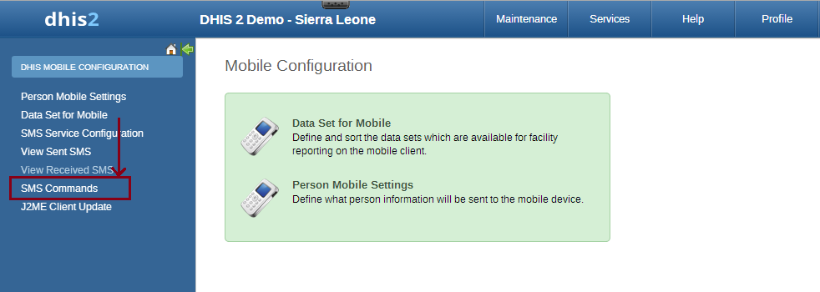
SMS Mobile Configuration

Slide 10
Add A Command
A command will be added – this is usually a key word which should relate to the type of elements that are to be captured – For example to configure a command for Attendances at a clinic. The Att or Atten would be ideal since you will be allocating attendance data elements to it.
After the Command has been added – you will click on edit to add the relevant data set and the allied data elements. Remember to leave the Parser – as Key Value Parser (which is the default)

Slide 11
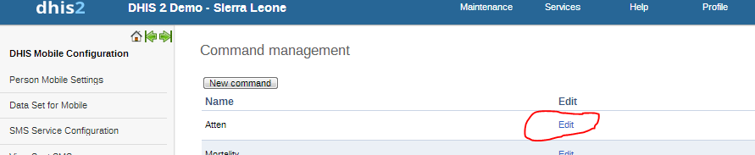
Editing the Command

Slide 12
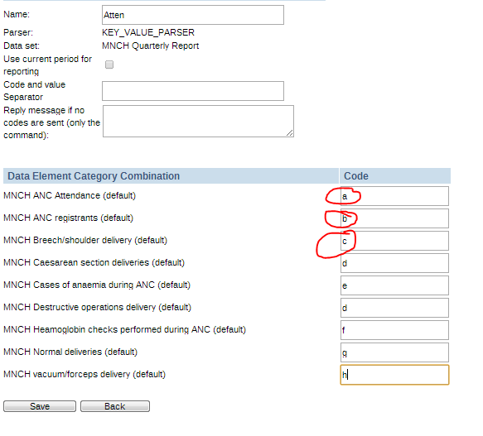
Editing the Command
The command done, the data elements will be added and each one given a code (this is the code that gets included in the text and that will carry values)

Slide 13
Add a User
The SMS gateway will need to access the server via a user who has access to the SMS Module (this user’s GSM number should also be a valid terrestrial telephone line – pls note the server DOES NOT INTERPRETE characters so the gateway user’s name SHOULD NOT include + but should have the valid country code) e.g.
2348075360533 √
+2348065360433 Χ

Slide 14
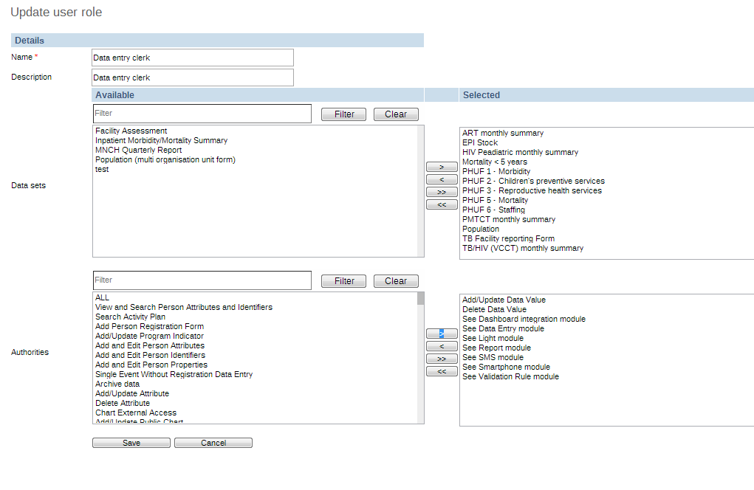
Add a User
Ensure the SMS User role can see the SMS Module

Slide 15
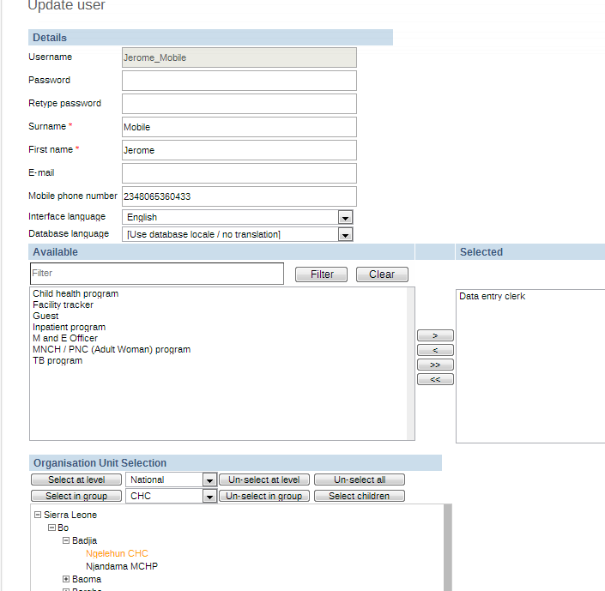
Add a User

Slide 16
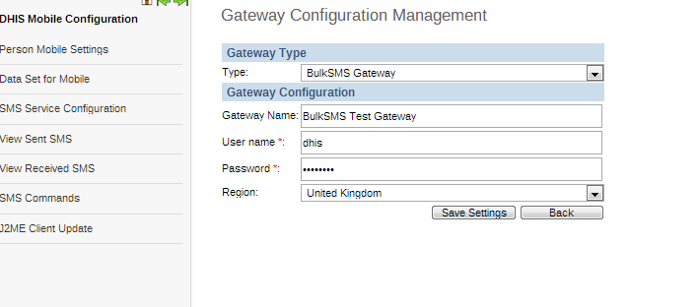
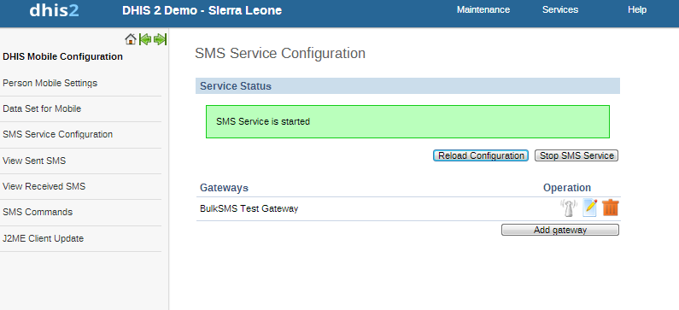
SMS Gateway
The SMS gateway relies on the Bulk SMS so you have to ensure that the Bulk SMS is started. This is done by editing the gateway configuration like this:

Slide 17
Configure the Gateway App.
The Gateway needs to point to the server using the Mobile User and the Key Word, in order to receive data.
Url – needs to point to the location of your server
http://192.168.1.2/academy2/dhis/sms/smsinput.action
DHIS2 username: Is the User Name that was configured for Mob
trump_Mobile (this format is NOT compulsory)
Commands to Forward (comma separated)
Atten

Slide 18
Pushing Data
To push data onto the server (after ALL configurations have been completed), the sender needs to construct his or her text message in the format that speaks to the previously constructed SMS command for example to push data for the Atten SMS command the following text will be constructed on the senders phone and pushed:
Atten a.y.b.n.c.y.d.y
The above SMS will be interpreted as
MNCH ANC Attendance: y
MNCH ANC Registrants: n
MNCH Breech/Shoulder Delivery: y
MNCH Caesarean Section Deliveries: y
MNCH Cases of Anemia during pregnancy: 56

